Slide 1

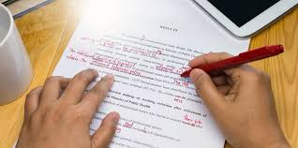
Academic Writing
Sections C & D
Presented by: Fatemeh Zununi
Spring 2020

Slide 2
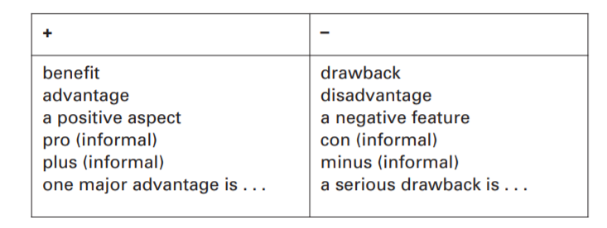
1. Argument and discussion
Discussion requires an evaluation of both the benefits and disadvantages of the topic, with a section of the essay, sometimes headed ‘Discussion’, in which a summary of these is made.

Slide 3
When discussing common ideas avoid personal phrases such as in my opinion or personally, I think . . . Use impersonal phrases instead such as:
It is generally accepted that working from home saves commuting time .
It is widely agreed that email and the internet reduce reliance on an office . . .
Most people appear to need face-to-face contact with colleagues . . .
It is probable that more companies will encourage working from home . . .
The evidence suggests that….

Slide 4
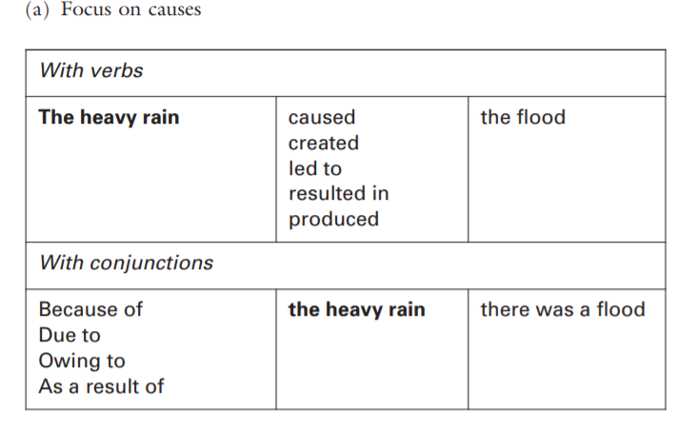
2. cause and effect
A writer may choose to put the emphasis on either the cause or the effect. In both cases, either a verb or a conjunction can be used to show the link.

Slide 5
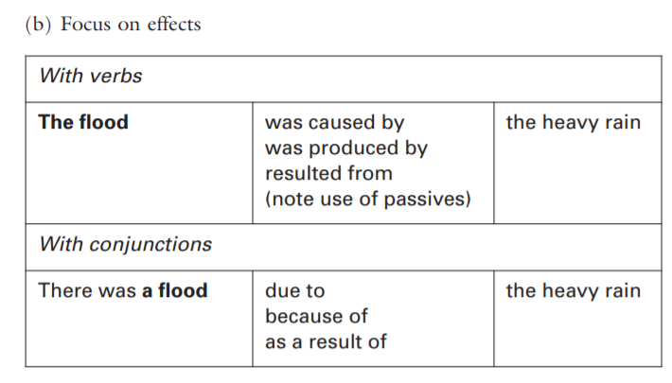

Slide 6
3. Generalizations
Generalizations are often used to introduce a topic. They can be powerful statements because they are simple and easy to understand. But they must be used with care, to avoid being inaccurate or too simplistic.
We can make generalizations by:
Most commonly using the plural: Computers have transformed the way we live.
Using the singular + definite article (more formal): The computer has transformed the way we live.
*hedging: young children learn better.
Young children tend to learn better.

Slide 7
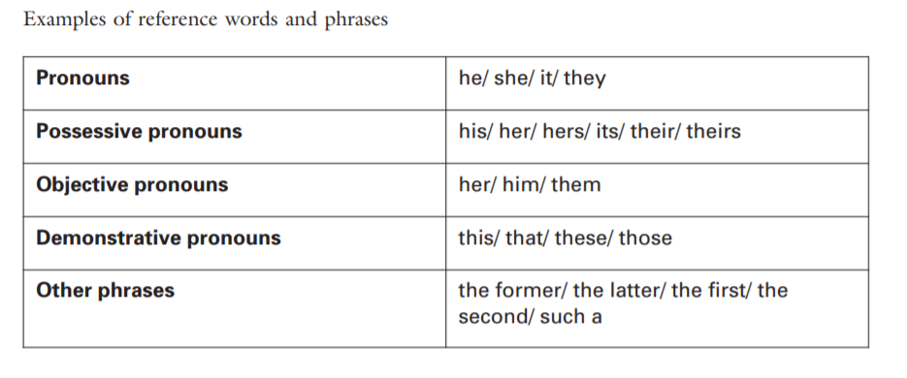
5. Cohesion, preventing confusion
Cohesion means joining a text together with reference words (e.g. he, theirs, the former) and conjunctions (e.g. but, then) so that the whole text is clear and readable.

Slide 8
6. Components of academic style
Do not use idiomatic or colloquial vocabulary: kids, boss. Instead use standard English: children, manager.
(b) Use vocabulary accurately. There is a difference between rule and law, or weather and climate, which you are expected to know if you study these subjects.
(c) Be as precise as possible when dealing with facts or figures. Avoid phrases such as about a hundred or hundreds of years ago. If it is necessary to estimate numbers use approximately rather than about.
(d) Conclusions should use tentative language. Avoid absolute statements such as unemployment causes crime. Instead use cautious phrases: unemployment may cause crime or tends to cause crime.

Slide 9
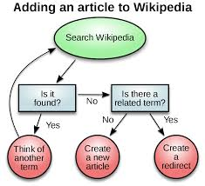
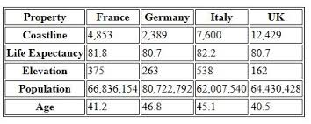
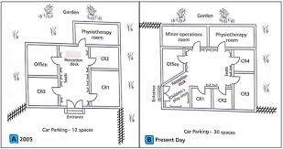
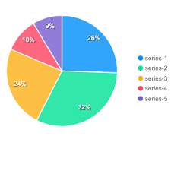
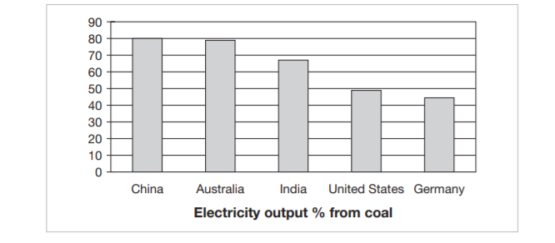
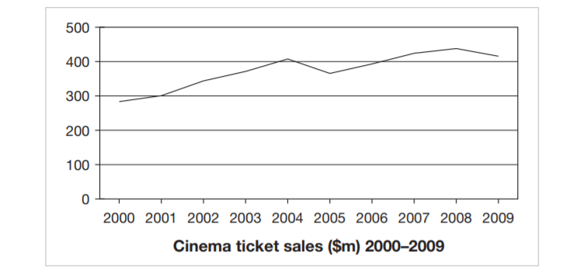
7. Visual information
1.diagram
2 table
3 map
4 pie chart
5 bar chart
6 line graph

Slide 10
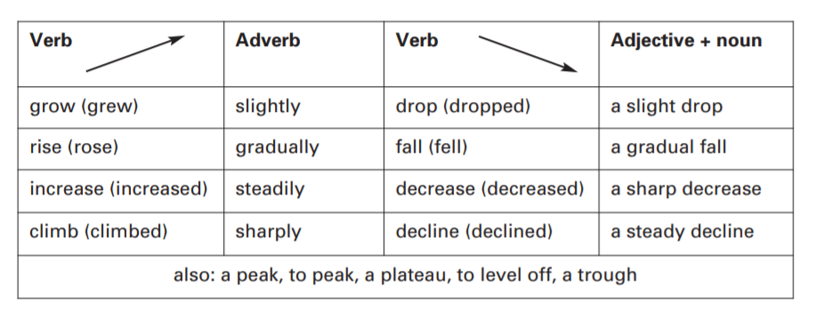
Vocabulary for the visual information
The …..Shows / Illustrates/ displays ….. (descriptive writing)

Slide 11
D. Accuracy in writing
Abbreviations and Acronyms
Academic vocabulary
Verb tenses
Articles
Caution
Conjunctions
Nouns and adjectives
Prefixes and suffixes
Prepositions
Punctuation
Singular or plural?

Slide 12
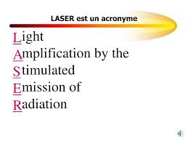
1. Abbreviations and Acronyms
Abbreviations are an important and expanding feature of contemporary English, widely used for convenience and space-saving.
USA / BBC/CNN/ RDCC
Acronyms are made up of the initial letters of a name or phrase
AIDS /ناجا /Scuba/ سمپاد

Slide 13
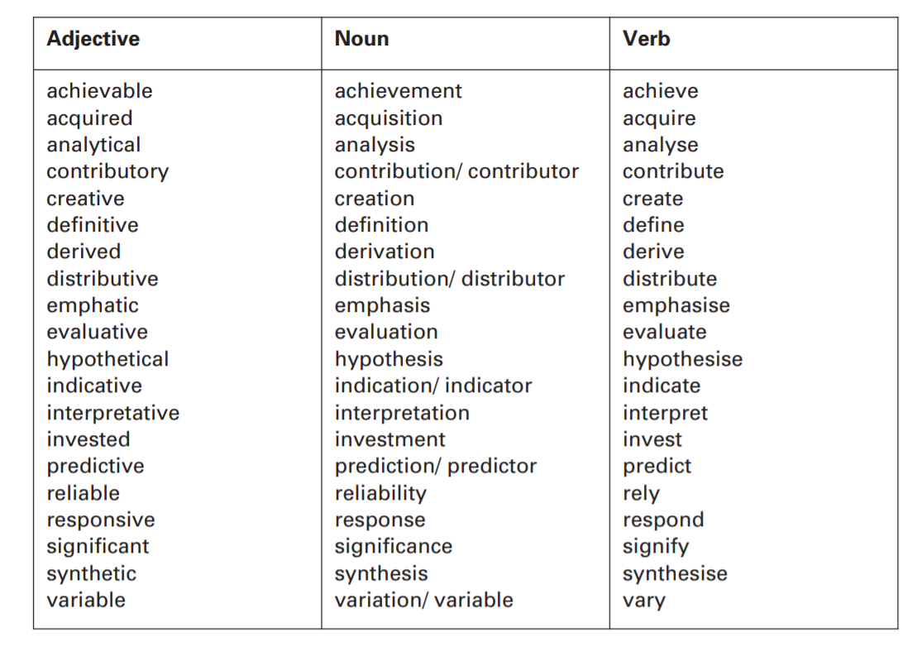
2. Academic vocabulary

Slide 14
pronunciation
Noun | verb | adjective
obligation | oblige | obligatory
industry | industrialize | industrial
stability | stabilize | stable
examination | examine | examined
demonstration | demonstrate | demonstrative
danger | endanger | endangered

Slide 15
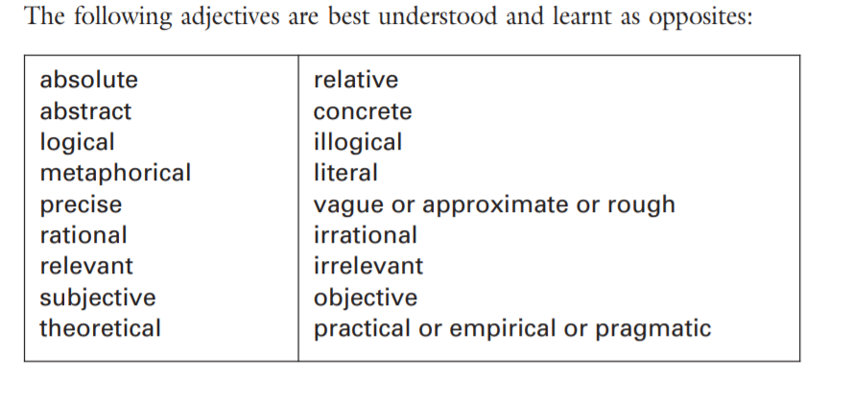

Slide 16
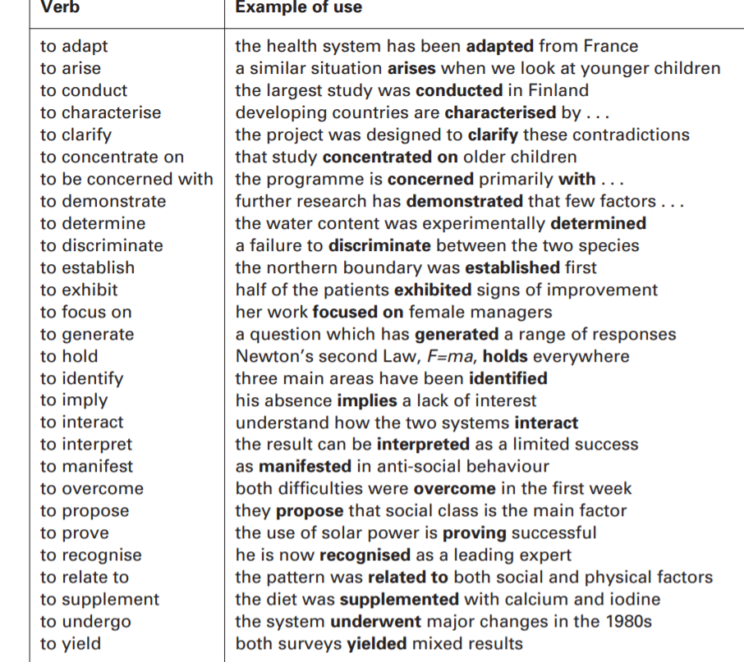

Slide 17
Collocations: verb+ noun / adjective+ noun
research
conduct
do
Carry out
Undertake
research
detailed
original
pioneering
extensive

Slide 18
Verb tenses: write (active voice)
Aspect/ tense | past | present | future
Simple (-) | I wrote a book. | I write a book. She/he writes a book. | I will write a book. I am going to write a book.
Continuous (be + ing) | I was writing a book. | I am writing a book. | I will be writing a book.
Perfect(have/had+ pp) | I had written a book. | I have written a book. She/he has written a book. | I will have written a book (by next year this time)
Perfect continuous (have/had+been+ing) | I had been writing a book. | I have been writing a book. | I will have been writing a book.

Slide 19
4.Verb tenses: write (passive voice)
Aspect/ tense | past | present | future
Simple (be+ pp) | A book was written. | A book is written | A book will be written.
Continuous (ing +pp) | A book was being written. | A book is being written. | ----------
Perfect(have/had+ been+pp) | A book had been written. | A book has been written. | A book will have been written.
Perfect continuous (……………) | ---------- | ---------- | ----------

Slide 20
  5. Articles (used for nouns)
Unless they are uncountable [U], all nouns need an article when used in the singular. The article can be either a/an or the.
Research is an important activity in universities.
(b) The research begun by Dr Mathews was continued by Professor Brankovic.
(c) An interesting piece of research was conducted among 200 patients in the clinic.

Slide 21
Decide why the is used, or not used, in the following examples.
(a) The world’s fastest animal is the cheetah.
(b) The USA was founded in the eighteenth century.
(c) The government increased taxation in the 1970s.
(d) The French Revolution was partly caused by bad harvests.
(e) The New Scientist is published every week.
(f) The south is characterised by poverty and emigration.
(g) Pablo Picasso, the Spanish artist, was born in Malaga.
(h) The River Seine runs through the middle of Paris.
(i) The United Nations was founded in 1945.
(j) The euro was introduced in 2002.

Slide 22
Uncountable nouns
Some/A piece of/ a little/a lot….
Information
Advice
news
Research
Writing
*paper
Happiness, sadness, love

Slide 23
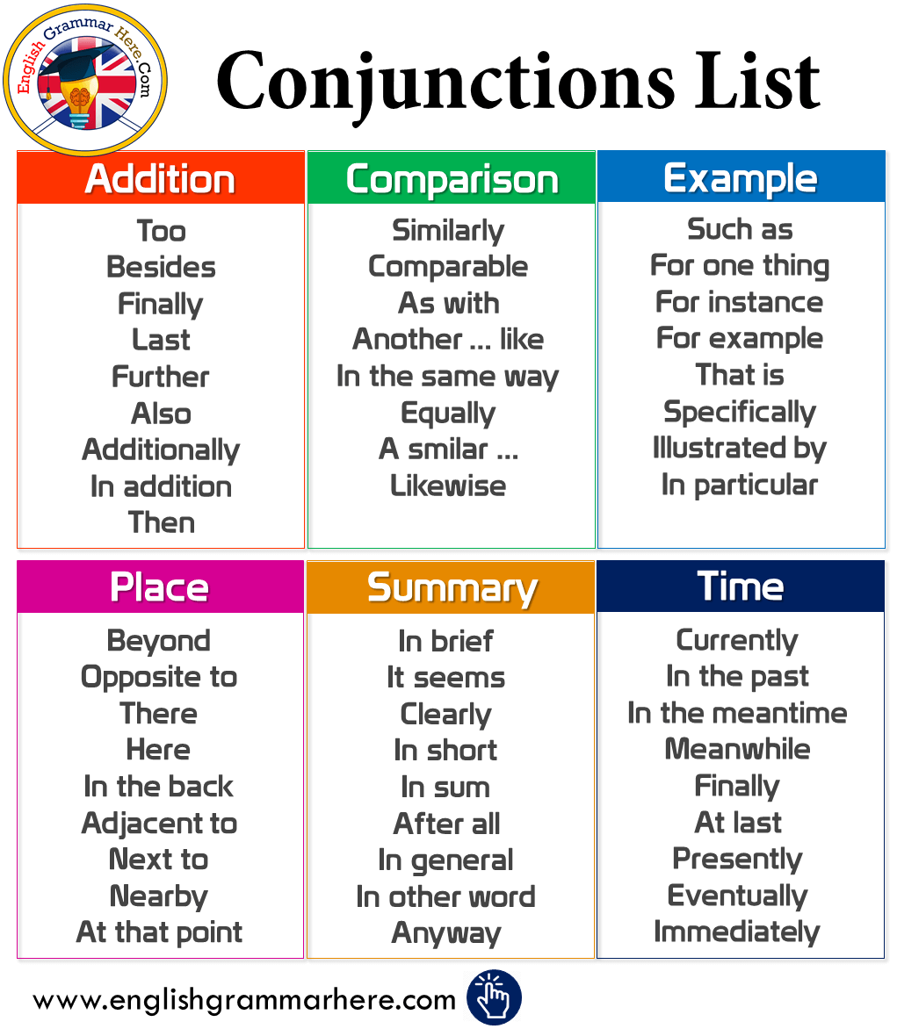
6. conjunctions
Conjunctions are words or phrases which join parts of a sentence together, or link a sentence to the next one.

Slide 24
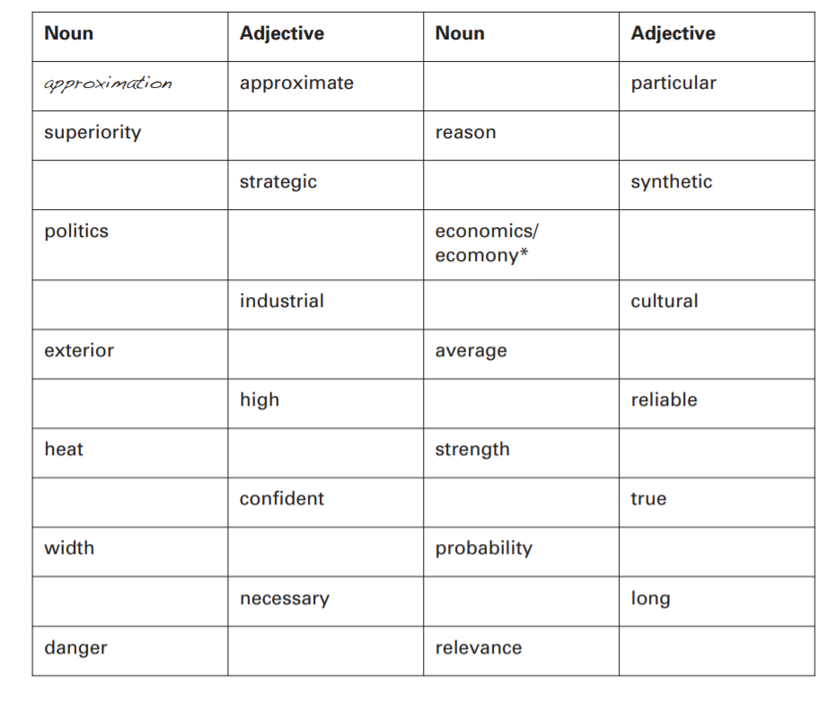
6. Nouns and adjectives

Slide 25
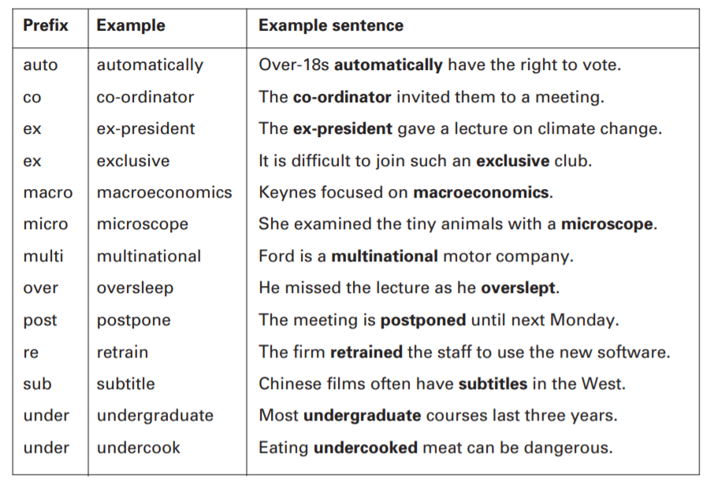
  7. Prefixes and suffixes

Slide 26
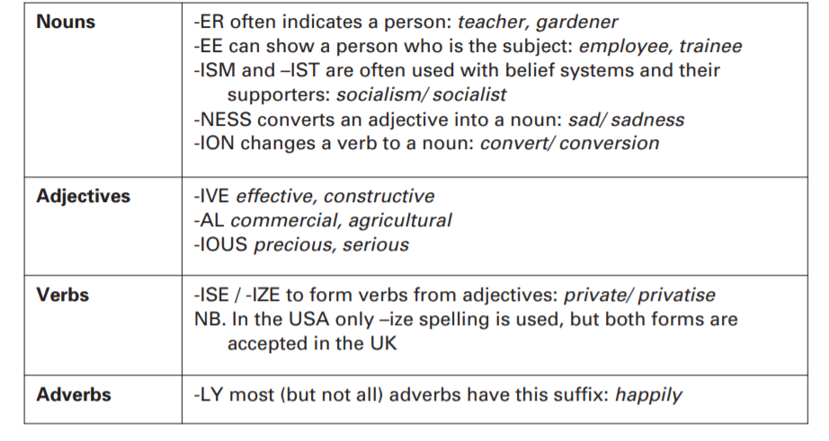
suffixes

Slide 27
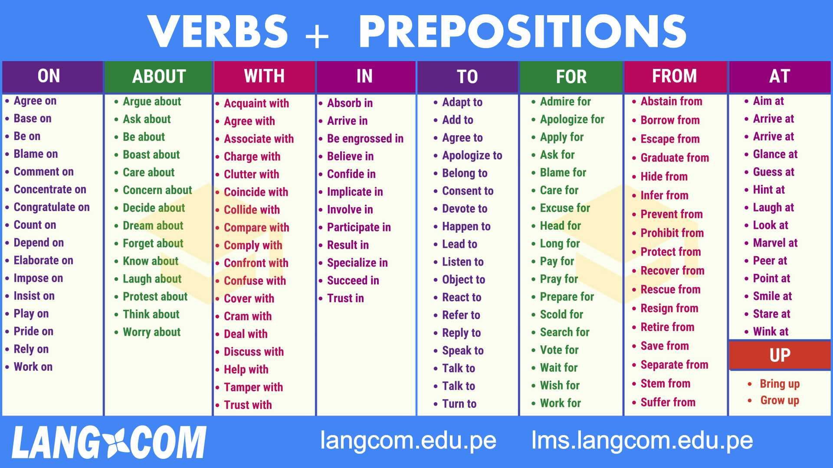
8. prepositions

Slide 28
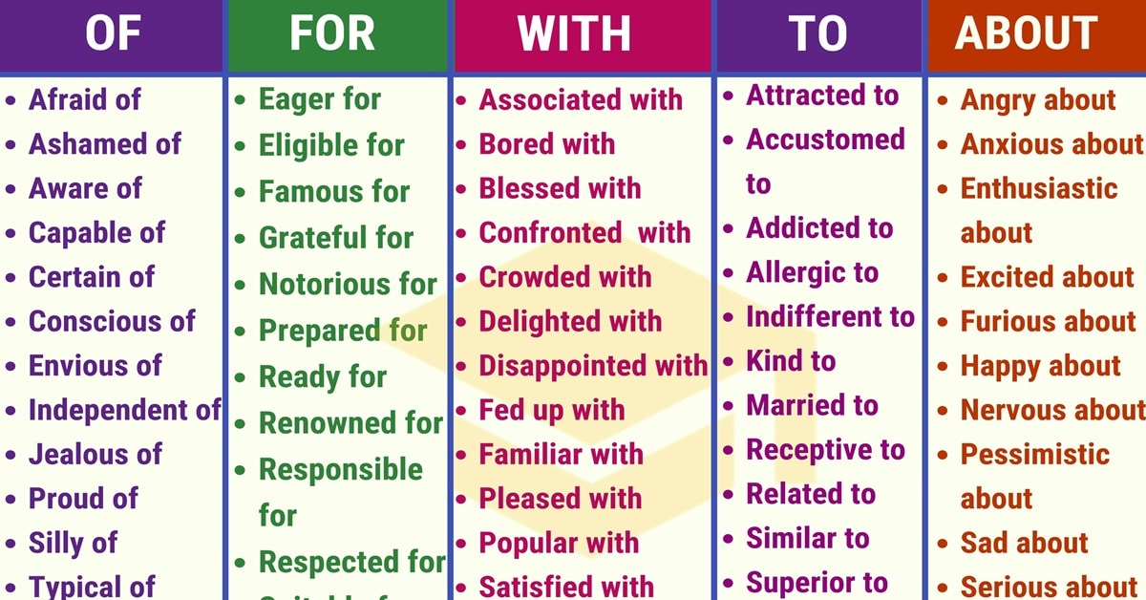

Slide 29
  9. Punctuation
Capitals
(a) The first word in a sentence In the beginning . . .
(b) Names of organisations Sheffield Hallam University
(c) Days and months Friday 21 July
(d) Nationality words France and the French
(e) Names of people/ places Dr Martin Lee from Sydney
(f) Book titles (main words only) Power and the State
Apostrophes ( ’ )
Semi-colons ( ; )
Colons ( : )
Commas
Quotations marks/ inverted commas (“ ”/ ‘ ’)

Slide 30
10.Singular or plural?
(a) Nouns should agree with verbs, and pronouns with nouns: Those problems are unique. There are many arguments in favour.
(b) Uncountable nouns and irregular plurals usually have no final ‘s’: Most students receive free tuition.
(c) General statements normally use the plural: State universities have lower fees.
(d) ‘Each/ every’ are followed by singular noun and verb forms: Every student gets financial support.
(e) Two linked nouns should agree: Both the similarities and differences are important.

Slide 31
Plural forms
Singular | Plural
mouse | mice
die | dice
ox | oxen
child | children
person | people*
penny | pence (in British usage)
Singular (-us) | Plural (-i)
focus | foci (also focuses)
radius | radii (also radiuses)
fungus | fungi
nucleus | nuclei
cactus | cacti
Singular (-f, -fe) | Plural (-ves)
knife | knives
life | lives
wife | wives
calf | calves
leaf | leaves
Singular | Plural (vowel change)
foot | feet
tooth | teeth
goose | geese
man | men
woman | women
Singular (-on/um) | Plural (-a)
phenomenon | phenomena
Criterion Bacterium curriculum | Criteria Bacteria curricula
Singular (-is) | Plural (-es)
axis | axes
analysis | analyses
crisis | crises
thesis | theses

Slide 32
Thanks for your
time and attention

